Slide 1


DEPARTMENT OF PHYSICS AND NANOTECHNOLOGY
SRM INSTITUTE OF SCIENCE AND TECHNOLOGY
18PYB103J –Semiconduuctor Physics
18PYB103J Module-II Lecture-7

Slide 2
Preview of lecture
The net flow of the ‘electron and holes’ in a semiconductor generates the current.
The process through which these charged particles move is called transport.
Two basic transport namely : Drift & Diffusion.
The carrier transport phenomena are the foundation for finally determining the current-voltage characteristics of semiconductor devices.
Subtopic :
Carrier Drift
Carrier Diffusion
18PYB103J Module-II Lecture-7

Slide 3
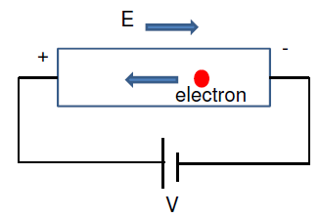
Carrier Transport
Drift
The electric field (E) is involved in the movement of the charge carrier.
Diffusion
The movement or flow of the charge carrier due to density gradient (dn/dx)
18PYB103J Module-II Lecture-7

Slide 4
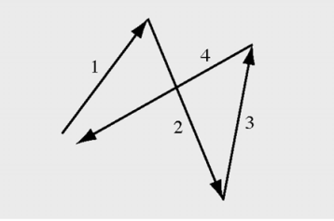
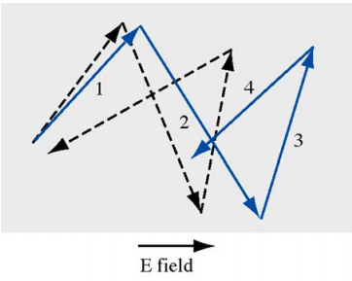
Carrier Transport Phenomena
Random motion of carriers without applied field
No net carrier displacement
Random motion and net movement along the direction of field
Net carrier displacement and thus a net velocity along the field.
This velocity is called the drift velocity, which gives drift current.
18PYB103J Module-II Lecture-7

Slide 5
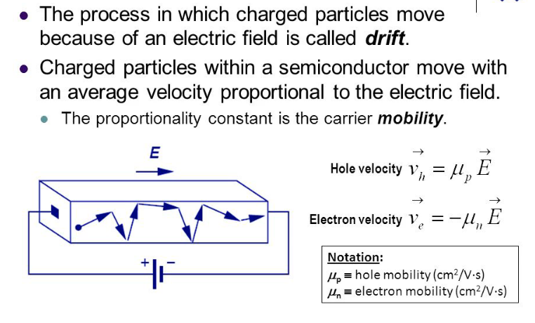
Carrier Drift
18PYB103J Module-II Lecture-7

Slide 6
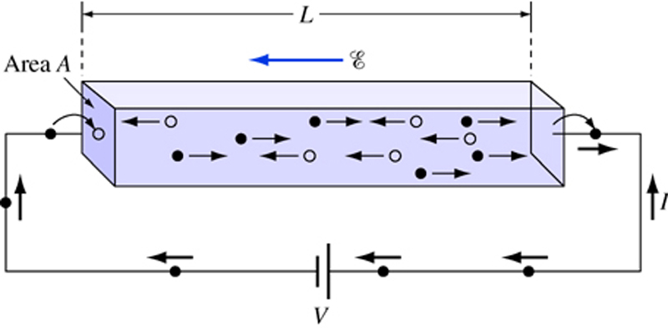
Current density
In semiconductors, It is useful to compare current density ‘J’ rather than current ‘I’
Ohm’s Law:
Where ρ is resistivity (in ohm-cm), L is length and A is cross-sectional area
18PYB103J Module-II Lecture-7

Slide 7
Let electric field be
I=JA and
Therefore
Or
Where is the conductivity (in ohm-cm⁻¹)
Note we added subscript “drift” to J
18PYB103J Module-II Lecture-7

Slide 8
The electric current density is given by
J=nev_{d ;} v_{d} is the drift velocity
The conductivity is σ = J/E = (nev_{d} /E)
σ = (ne /E) (eEτ/m) with v_{d =} (eEτ/m)
σ = (ne²τ/m) , τ is the relaxation time between collisions
Again v_{d =} μ E, μ is the mobility of charge carrier within the crystal.
Thus, J = nev_{d} = ne μ E
σ = J/E = ne μ
or in terms of resistivity ρ
ρ = 1/ σ = 1/ ne μ
If the material is a semiconductor, the current flow would be due to electron and hole movement.
18PYB103J Module-II Lecture-7

Slide 9
Correspondingly the current densities due to electron drift and hole are:
J_{n} (drift) = n μ_{n} eE
J_{p} (drift) = p μ_{p} eE
J (drift) = J_{n} (drift) + J_{p} (drift)
J (drift) = n μ_{n} eE + p μ_{p} eE
Comparison with J = σ E
σ = n μ_{n} e + p μ_{p} e
For an intrinsic semiconductor n = p = n_{p}
σ_{i =} n_{i}e(μ_{n +} μ_{p} )
18PYB103J Module-II Lecture-7

Slide 10
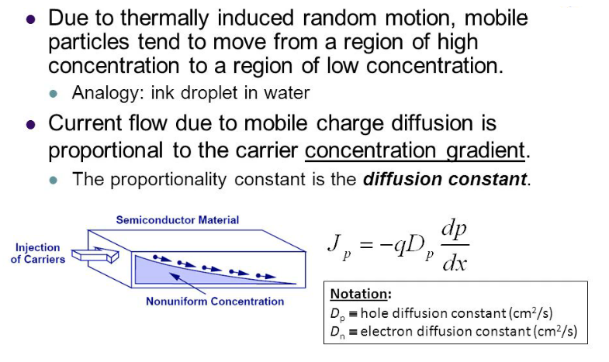
Carrier Diffusion
18PYB103J Module-II Lecture-7

Slide 11
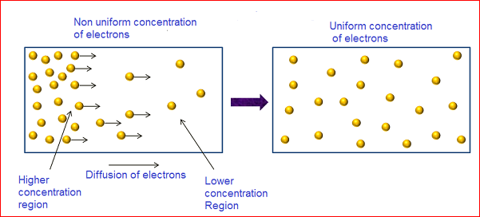
Diffusion Current
The electrons present at left side of the semiconductor material that moves to right side, to reach the uniform concentration of electrons.
The semiconductor material achieves equal concentration of electrons. Electrons that moves from left side to right side will constitute current. This current is called diffusion current.
.
In p-type semiconductor, the diffusion process occurs in the similar manner.
18PYB103J Module-II Lecture-7

Slide 12
Let us suppose that the concentration Δn of electrons varies with distance x
In the semiconductor, the concentration of gradient being
d(Δn) /dx
Fick’s law states that the rate at which carriers diffuse is proportional to the density gradient and the movement is in the direction of negative Gradient, the rate of flow of electrons is proportional to
d(Δn) /dx
From which the rate of flow across unit area is got, equal to
-D_{n} d(Δn) /dx , Where D_{n} is the diffusion coefficient for electron
J_{n}( diffusion) = -(e) (rate of flow across unit area)
= eD_{n} d(Δn) /dx
18PYB103J Module-II Lecture-7

Slide 13
If an excess hole concentration is created in the same region, hole
Diffusion takes place in the same direction at a rate per unit area
= - D_{p} d(Δp) /dx
Resulting in a hole diffusion current density.
J_{p}( diffusion) = +(e) (rate of flow across unit area)
= - eD_{p} d(Δp) /dx . Where D_{p} is the hole diffusion coefficient
If there is an electric field E and a concentration gradient in the x-direction,
the total hole current is the sum of the drift current.
J_{p} = J_{p} (drift) + J_{p} (diffusion)
J_{p} = peμ_{p} - eD_{p} d(Δp) /dx
Similarly for electrons, the total current density
J_{n} = neμ_{n} + eD_{n} d(Δn) /dx
18PYB103J Module-II Lecture-7

